Slide 1
Data Augmentation and Segmentation with GANs for Medical Imag
Hoo Chang Shin

Slide 2
This DLI is based on
Medical Image Synthesis for Data Augmentation and Anonymization using Generative Adversarial Networks
https://arxiv.org/abs/1807.10225
TensorFlow GAN example
https://github.com/tensorflow/tensorflow/blob/master/tensorflow/contrib/eager/python/examples/gan/mnist.py
TensorFlow pix2pix GAN example
https://github.com/tensorflow/tensorflow/tree/master/tensorflow/contrib/eager/python/examples/pix2pix

Slide 3
Goals
Generate synthetic brain MRI
Use GAN for segmentation
Segment brain anatomy
Segment disease
Brain tumor (BRATS challenge - https://www.med.upenn.edu/sbia/brats2018/data.html)
Ischemic stroke lesion (ISLES challenge - http://www.isles-challenge.org/)
Use GAN to improve segmentation on limited data

Slide 4
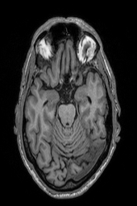
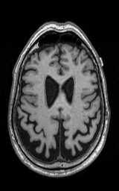
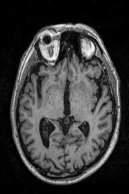
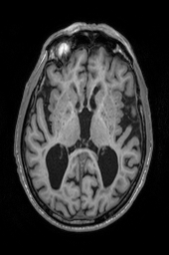
Generate synthetic brain MRI
From random numbers
Code:
gan2d.py
Data:
https://drive.google.com/file/d/1CXwE8Lhya_f1nMGppTF5ek98NxaZIM_6/view?usp=sharing
Run: python gan2d.py –data_dir=[where_the_adni_png_t1_images_are]
(and it’ll generate brain MRI images every 15th epoch, and after final epoch)

Slide 5
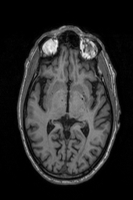
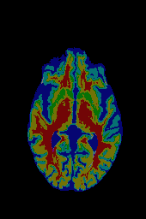
Segment brain anatomy
Conditional GAN (pix2pix)
https://arxiv.org/abs/1611.07004
Code:
pix2pix2d.py
Data:
https://drive.google.com/file/d/1PuadqCndYzHx6bKescS6XApy9IgYphn6/view?usp=sharing
Run: python pix2pix2d.py –data_dir_A=[adni_t1_png_images] –data_dir_B=[adni_seg_label_images]

Slide 6
Generate brain MRI from label
Conditional GAN (pix2pix)
https://arxiv.org/abs/1611.07004
Code:
pix2pix2d.py
Data:
https://drive.google.com/file/d/1PuadqCndYzHx6bKescS6XApy9IgYphn6/view?usp=sharing
Run: swap the –data_dir_A and –data_dir_B from the previous run and it’s label->image

Slide 7
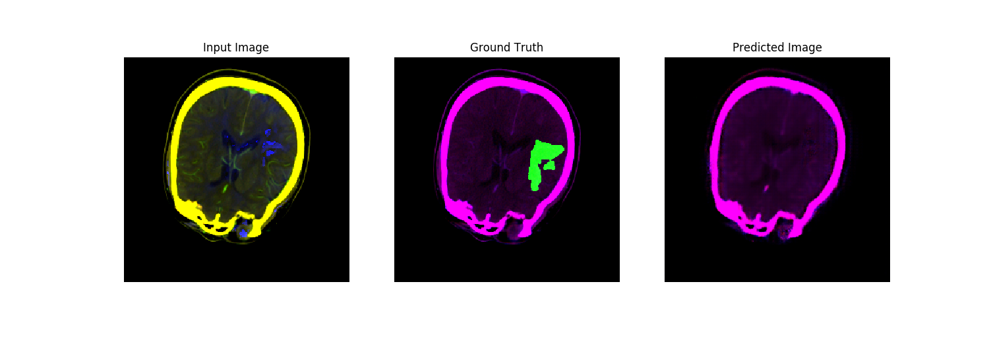
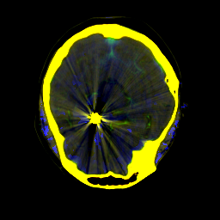
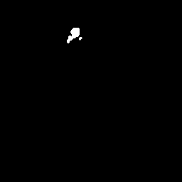

Segment Ischemic Stroke Lesion
It is a challenging problem
High dimensional data (Diffusion MRI, Perfusion maps, CT)
Limited data
Simply applying pix2pix doesn’t work
We use the script from https://github.com/khcs/brain-synthesis-lesion-segmentation/blob/master/utils/isles18_sample_2d.ipynb to sample 2D slices from 4D ISLES multi-modal data.
RGB image ver1 - R: CT; G: DWI (dimension condensed with PCA); B: time to peak of the residue function (Tmax)
RGB image ver2 – R: cerebral blood flow (CBF); G: cerebral blood volume (CBV); B: perfusion map (MTT)
Try running pix2pix2d with –input_data_A=[RGB image ver1/2] –input_data_B=[ground truth]
It doesn’t work – why? Because input dimension is high, labels are highly imbalanced so loss is very small. It segments (predicts) nothing.

Slide 8
How to improve using GAN
Within the training dataset, train the conditional GAN (pix2pix) to translate one modality to another (e.g., DWI to Diffusion map)
Transfer learn to segment stroke lesion from DWI and CT
A way of improving performance on limited data!
Code:
pix2pix2d.py
Data:
https://drive.google.com/file/d/1KwjLP8Q9m_mre6NKOPEsgkI2h9gA3XSk/view?usp=sharing
Run:
python pix2pix2d.py –data_dir_A=[RGB image ver 1] –data_dir_B=[RGB image ver2] –output_file_dir=[name a directory]
python pix2pix2d.py –data_dir_A=[RGB image ver 1] –data_dir_B=[segmentation label image] –output_file_dir=[the previous directory we named, or we make a new one and copy the checkpoints, so we can do transfer learning] –restore_checkpoints=True –swap_noise_imB_channel_13=True
Note that also we make segmentation label to have first and last parametric images of DWI – so the loss gets more balanced – try only with labels
# last option is to emphasize what we really need to do is segment the stroke lesion – it swaps first and last channels of the 3-channel label image and add noise to these – try without this

Slide 9
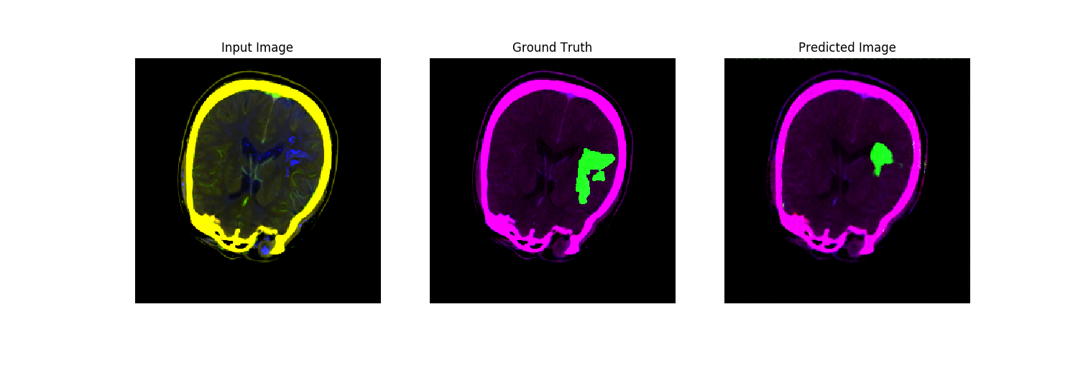
How to improve using GAN

Slide 10
Exercise
Replace the U-Net in the generator with ResNet
Code:
pix2pix2d.py
Extend it to 3D
Code:
pix2pix3d.py
Data:
https://drive.google.com/file/d/1kTu2sTz8Q8GIMYVyFLnYtynpZSqvvAIB/view?usp=sharing
Run:
Same as before – train from image-ver1 to image-ver2, fine-tune to image-ver1 to segmentation-label with swap_noise_imB_channel_13
and when we do this will generate more coherent lesion shape in 3D (vs. when doing in 2D slices independently, slice to slice prediction may differ and lower performance)
Generate more synthetic data to improve training
Like in the paper: https://arxiv.org/abs/1807.10225
Any other ways to improve the performance?
Like –disc_dim_method=patch-based so positive-vs-negative samples are more balanced (but training takes too long with this approach, most of the time spent in sampling)
Any other ideas?
Submit your own awesome result to ISLES challenge using the scripts provided in
https://github.com/khcs/brain-synthesis-lesion-segmentation/blob/master/utils/merge_2d_test_to_nii.py
https://github.com/khcs/brain-synthesis-lesion-segmentation/blob/master/utils/convert_3d_test_to_nii.py

